Slide 1
Telecommunications Customer Churn Prediction
Trainer: Rajashekar
Group 2
Sangeetha Ranjit
Devarakonda Sai Sanath
Madhumathi Rajesh
Jillela Ravi Kiran
Akhil Vennavalli
Shivam Kumar Sahu

Slide 2
Objective
To model churn probability, conditioned on the customer features.
The data provided contains a total of 19 features for 3333 customers.
Each row corresponds to a client of a telecommunications company. Information collected contains the type of plan they have contracted, the minutes they have talked, or the charge they pay every month.
Data Set

Slide 3
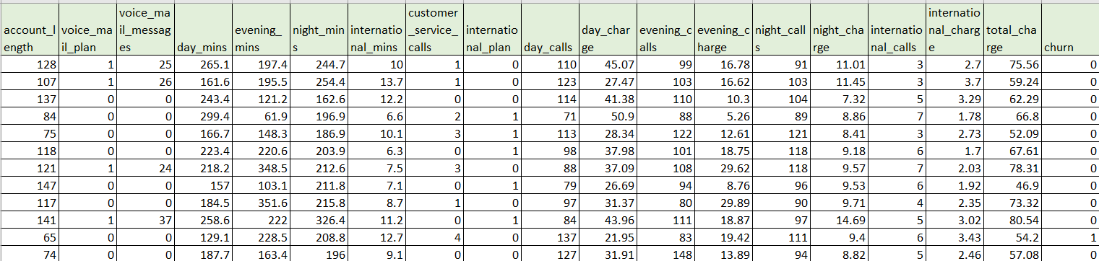
Data Set

Slide 4

Why Model Customer Attrition?
It is far more expensive to acquire new clients than to keep current ones. According to certain surveys, acquiring a new customer can cost six to seven times more than retaining an existing one.

Slide 5

Data Cleaning and Exploratory Data Analysis.
Model Selection and Threshold Tuning.
Result Interpretation.
Understanding the data
Model Building
Deployment

Slide 6
Exploratory Data Analysis
Get maximum insights from a data set.
Uncover underlying structure.
Extract important variables from the dataset.
Detect outliers and anomalies(if any)
Test underlying assumptions.
Determine the optimal factor settings.

Slide 7
Libraries
Importing necessary libraries
Importing necessary libraries for the basic analysis and understanding of the data. The dataset contains 3333 rows and 19 columns.
Loading and importing values
Reading the data set in detail
Read the dataset and view a sample of 10 random rows.
Checking the data types in each column - The dataset includes 2 datatypes – float64 and int64
Checking the column headers to understand the features of most and least importance for the objective
Check for null values – no null values found
Checking for unique values
Feature of importance
Churn
Printing the count of True or False in the 'Churn' Feature
Observation:
2850 – non churners
483 – Churners

Slide 8
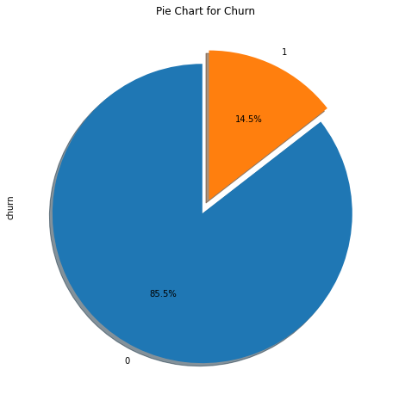
Analysing the target value - Churn
It is observed that 85.5% of of the customers are non churners and 14.5% are probable churners.

Slide 9
Analysing other individual features with targeted variable
Account Length
212 unique values
Highest Churning rates are from 208,02,188,225,224,212,23,17,44,24
Voice mail plan
In 922 members who have Voice mail plan the churn rate is 8.6%
International plan
323 customers have international plan out of which
42.4 % people churn.
Voice mail messages
If there are more than 20 voice-mail messages, the probability of the customer churning is high
Customer service calls
Customers who call the service centre 5 times or more have > than 60% chances of churn

Slide 10
Analyzing all calls minutes, all calls, all calls charge together - As these data sets are numerical and ‘churn’ being categorical type we are using mean, median, and box plots for the analysis.
Day[minutes, calls, charge] Day minutes and charges are positively corelated. Higher day mins🡪Higher charges🡪Greater churn probabiliy
Evening[minutes, calls, charge]
Low corelation between evening minutes and charges [minutes, calls, charge]🡪No much churn
Night [minutes, calls, charge]
Low corelation between night minutes and🡪No much churn

Slide 11
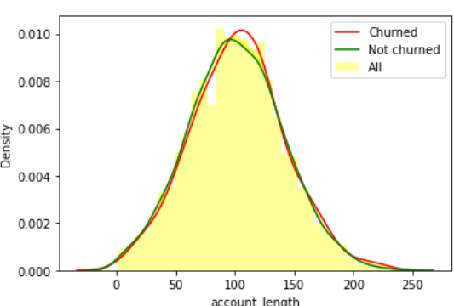
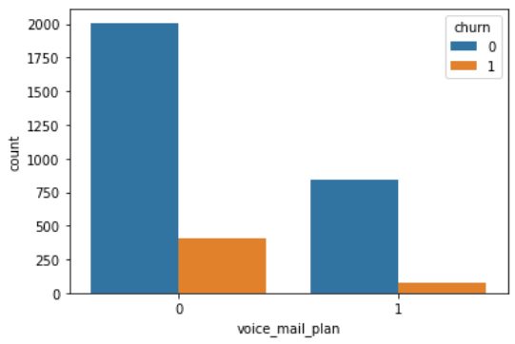
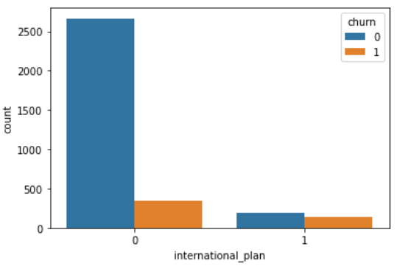
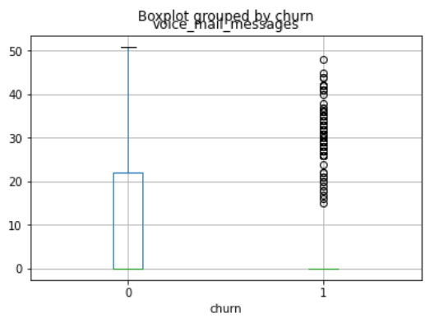
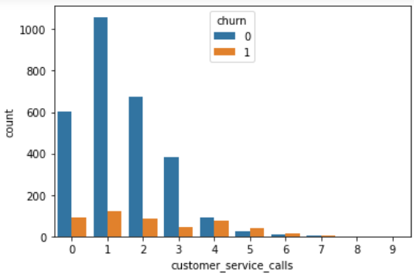
Graphical Representation

Slide 12
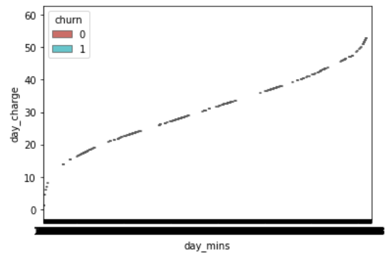
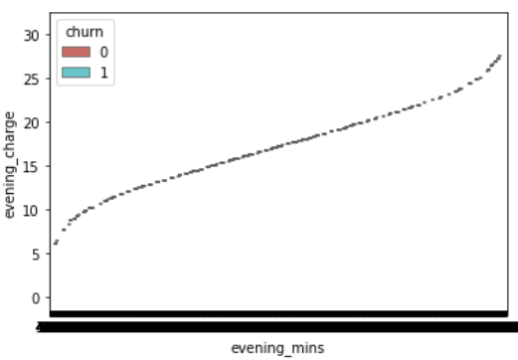
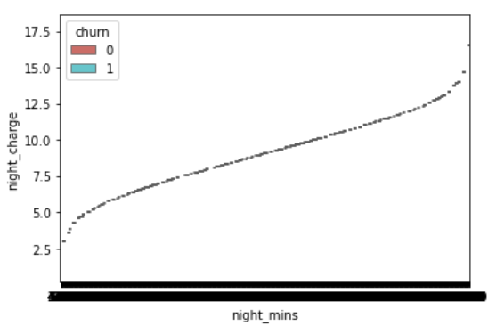
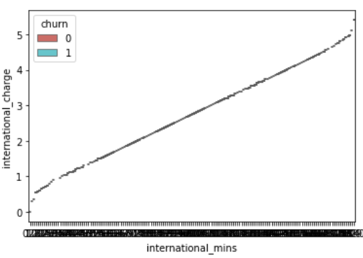

Slide 13
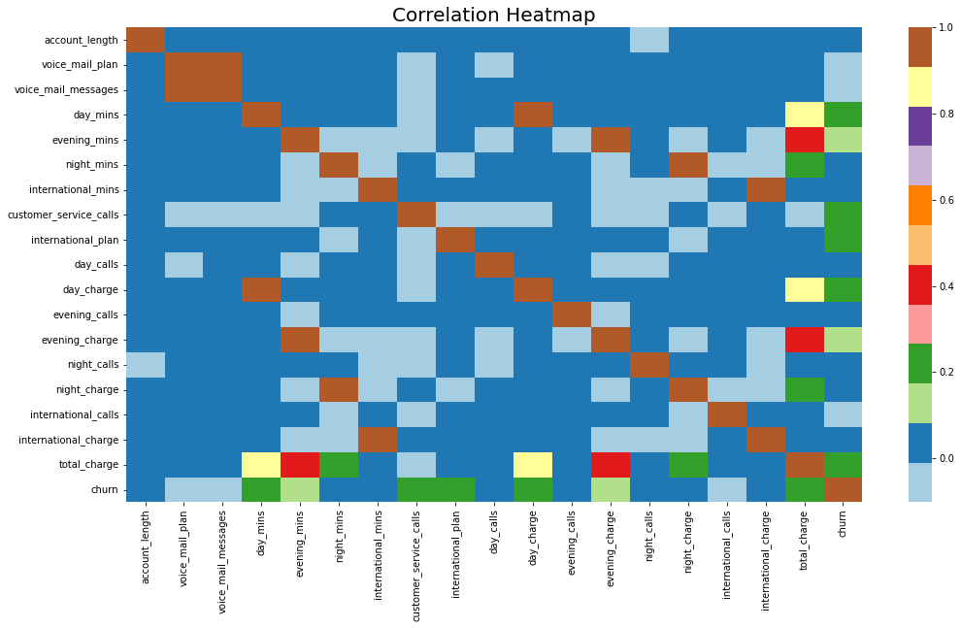
Feature -to-feature correlation is mapped out using a heatmap and features that are highly correlated to one another are dropped.

Slide 14
Insights:
Day charge and day minutes are highly correlated
Evening charge and Evening minutes are highly correlated
Night charge and Night minutes are highly correlated
International charge and International minutes are highly correlated
Churn Variable correlation with independent variables:
Day mins : 21%
Customer Service Calls : 21%
International Plans : 21%
Day Charge : 21%
Total Charge : 23%

Slide 15

Oversampling the imbalanced Data
Dropping features of less importance - account_length,day_calls,evening_calls,night_calls,international_calls
Using SMOTE - Synthetic Minority Oversampling Technique
Duplicating examples from the minority class in the training dataset prior to fitting a model
Output:

Slide 16
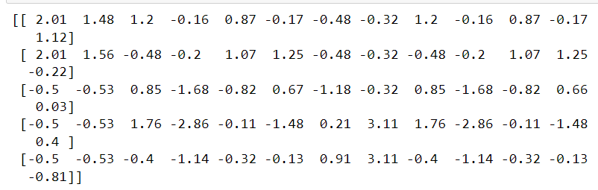
Feature Scaling
Feature scaling through standardization an important preprocessing step to rescale the features such that they have the properties of a standard normal distribution with a mean of zero and a standard deviation of one. StandardScaler applied, to unscaled data.

Slide 17
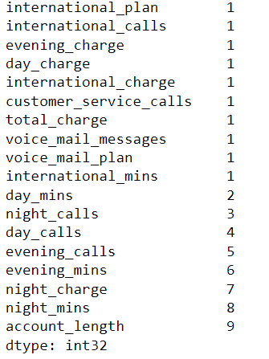
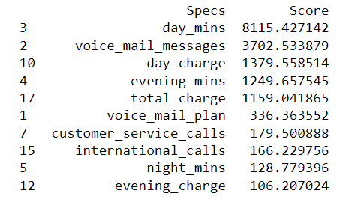
Feature Engineering - Selection, manipulation, and transformation of raw data into features
Chi Squared Test
Recursive Feature Elimination

Slide 18
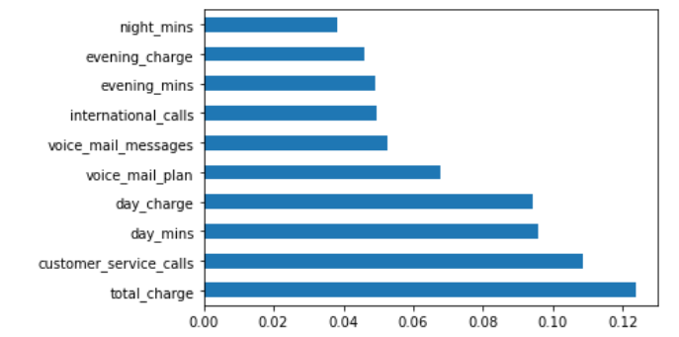
It is observed that total_charge, customer_service_calls, days_mins, day_charge and voice_mail plans are of more importance in affecting the churn probability of a customer.
Extra Trees Classifier

Slide 19
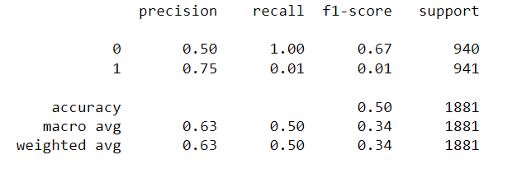
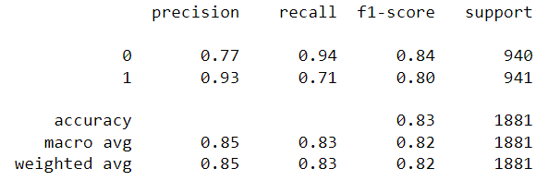
Model Building
Logistic Regression Decision Tree Classifier

Slide 20
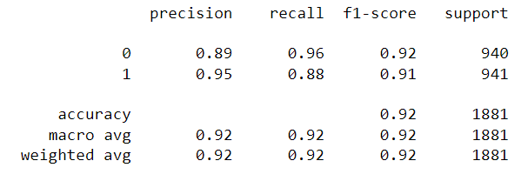
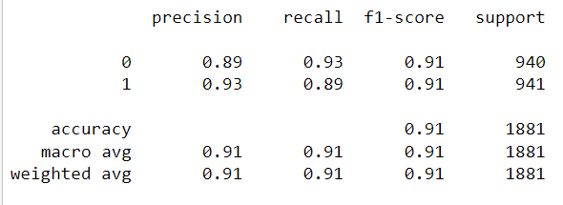
Random Forest Classifier
XG Boost Classifier

Slide 21
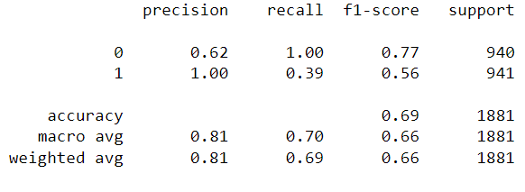
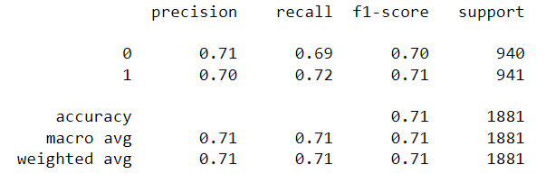
SVM
Categorical NB

Slide 22
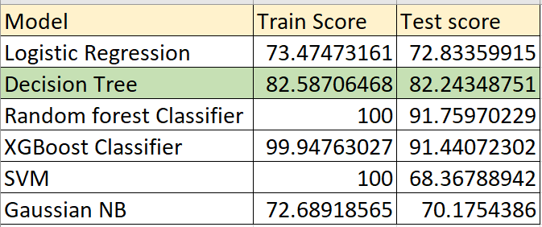
Insights from the Model Building:
We observe that Decision Tree Classifier model has a fair recall and hence we proceed with the model deployment using the same.

Slide 23
Major challenges faced
Imbalanced data - Predictive modelling is challenged by imbalanced classifications because the majority of machine learning methods for classification are built on the premise that there should be an equal number of samples for each class. As a result, models perform poorly in terms of prediction, notably for the minority class.
Multiple outliers – Multiple data points that differ significantly from other observations.
– The model learns the information and noise in the the training data to the point where it adversely affects the model's performance on fresh data
How did we overcome:
Imbalanced data: Using imbalanced-learn library and applied SMOTE enabling a balance for the target variable in our dataset – CHURN
Outliers: Normalized the data set by feature scaling using RFC and XGBoost due to the difference in training and testing accuracy that may lead to overfitting.
Overfitting: Chose the DecisionTreeClassifier model for better accuracy of the training and testing datasets.

Slide 24
Challenges faced
Imbalanced data
Predictive modelling is challenged by imbalanced classifications because the majority of machine learning methods for classification are built on the premise that there should be an equal number of samples for each class. As a result, models perform poorly in terms of prediction, notably for the minority class.
Multiple outliers
Over fitting
The model learns the information and noise in the the training data to the point where it adversely affects the model's performance on fresh data
Multiple data points that differ significantly from other observations

Slide 25
How did we overcome
Imbalanced data
Using imbalanced-learn library and applied SMOTE enabling a balance for the target variable in our dataset – CHURN
Outliers
Normalized the data set by feature scaling using RFC and XGBoost due to the difference in training and testing accuracy that may lead to overfitting.
Overfitting
Chose the DecisionTreeClassifier model for better accuracy of the training and testing datasets.

Slide 26
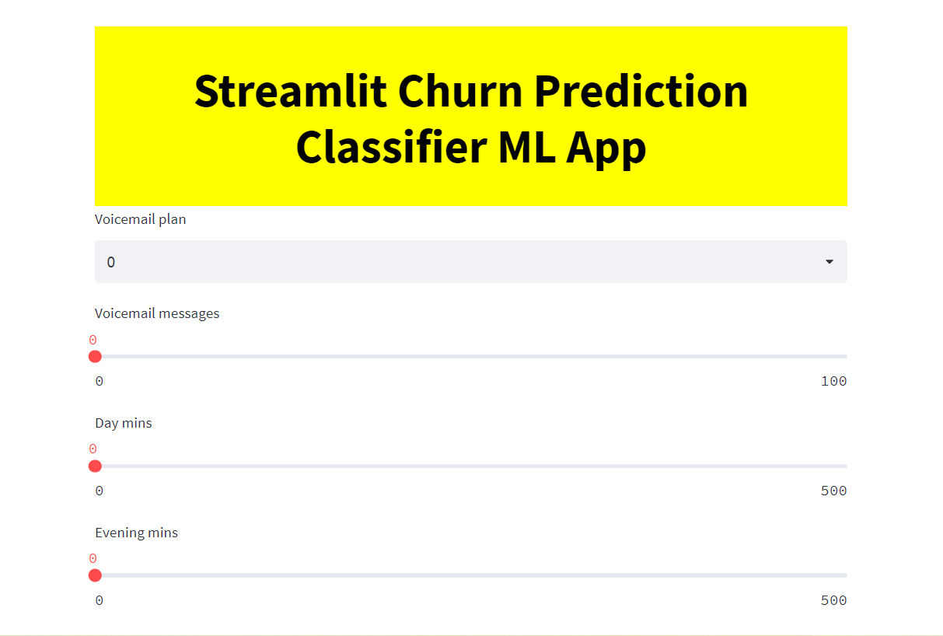
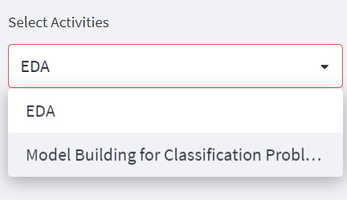
Deployment
Model deployed using pickle and executed using Streamlit.
The model consists of 2 sections, EDA and Model Building for Classification problem.

Slide 27
Thank You

